Slide 1
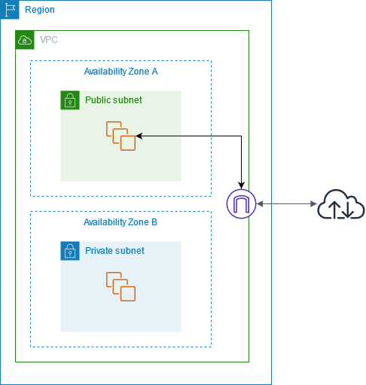
Vpc max:/16=65536ip’s
min/28=16 ip’s
Subnet
max :/24=256
min:/28=16 ip’s
251
Internet Gateway
Vpc =10.0.0.0/24=256 ip’s
5 ip’s =aws
251
Pub Sub =2^32-25=2^7=

Slide 2
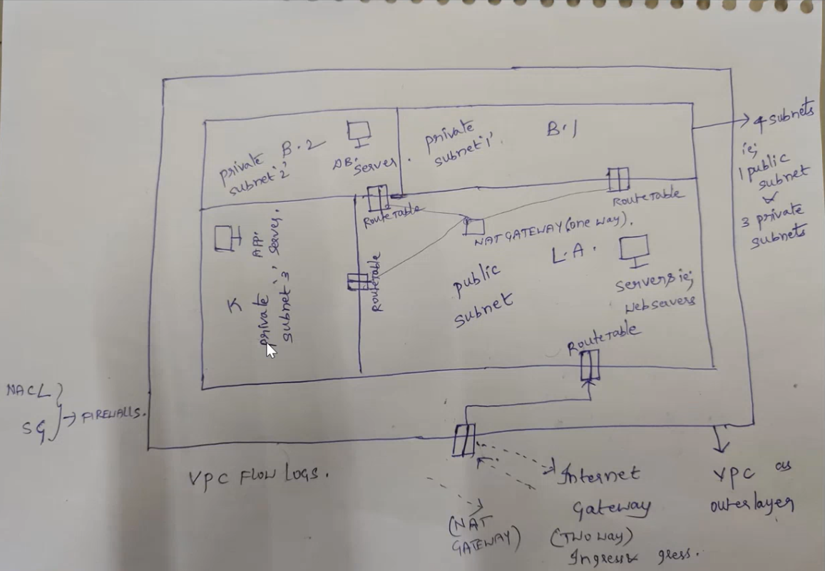

Slide 3
2^7=2*2*2*2*2*2*2=128
251-128=123
2^32-26=2^6=64
Vpc=10.0.0.0/24 =vpc
Sub=10.0.0.0/28=16 ip10.0.0.0,10.0.0.1,10.0.0.2 …..15
Sub=10.0.0.16/28

Slide 4
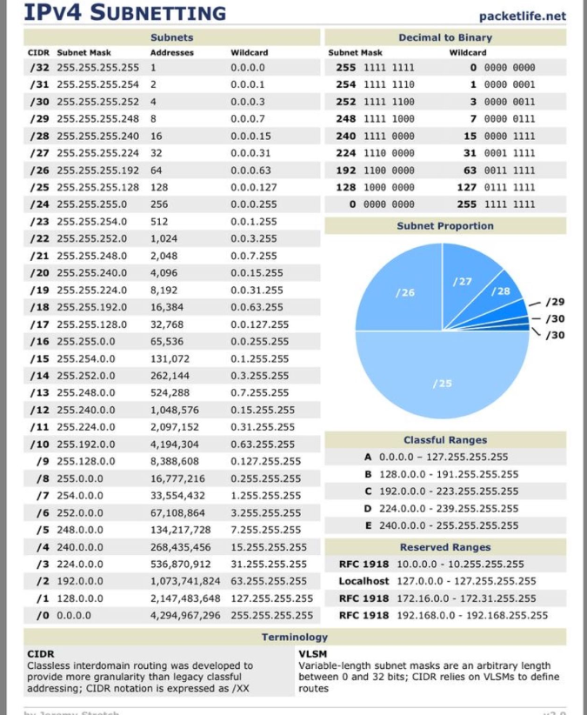

Slide 5
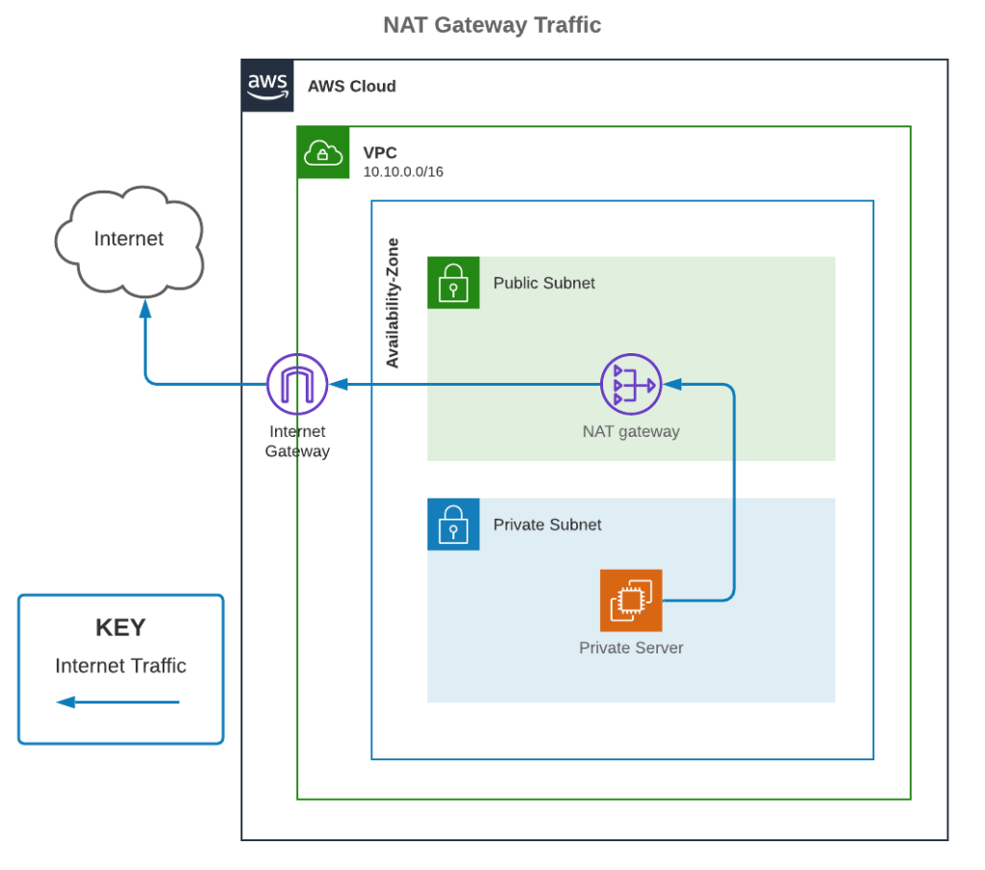
Availability Zone -a
Availability Zone -b

Slide 6
Region
VPC1
VPC2
Finance Team
HR Team
VPC3
VPC4
Accountancy team
IT Team

Slide 7
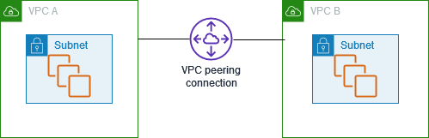

Region
Internet Gateway

Slide 8
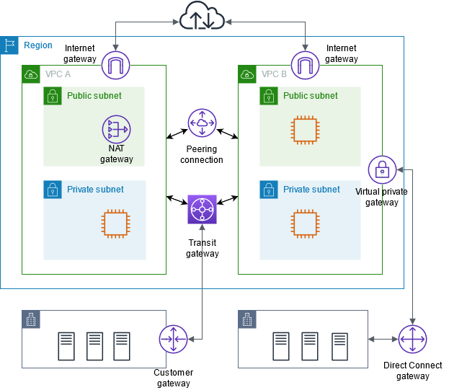

Slide 10
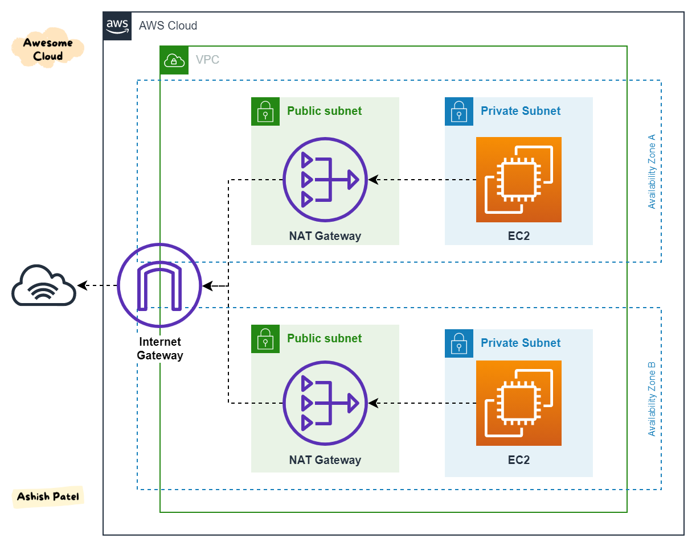

Slide 11
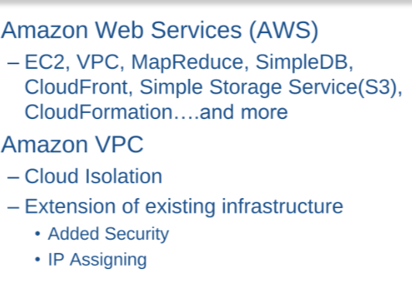

Slide 12
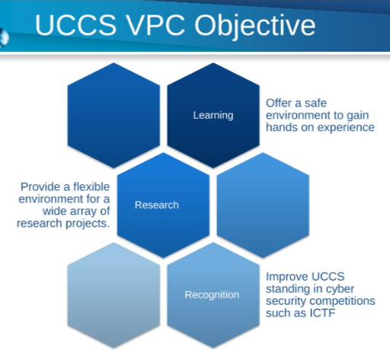

Slide 13
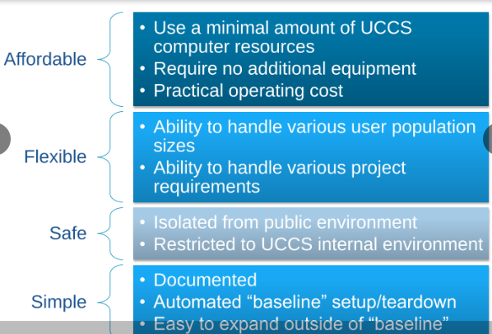

Slide 14
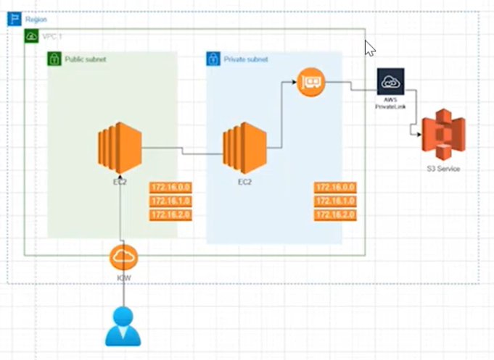

Slide 15
Handson for vpc End-point:
1.create vpc along with that create one public subnet and private subnet.
2.i have provided the internet connection to vpc and than public subnet.
3.if one vpc i created means by default one route table will be created.
go to routes & create another route table.
and edit routes and finally attach the internet gateway to public subnet.
4.create ec2 servers in public and private servers for allowing iam services to access S3-role.
5.go to vpc and create vpc Endpoint connection.
6.add security group for endpoints to the private subnet server to access the endpoint connection.
7.go to putty and take the public server ip and check whether your s3 service is accessing or not.
8.for private server go with new window and search for aws private link for amazon s3

Slide 16
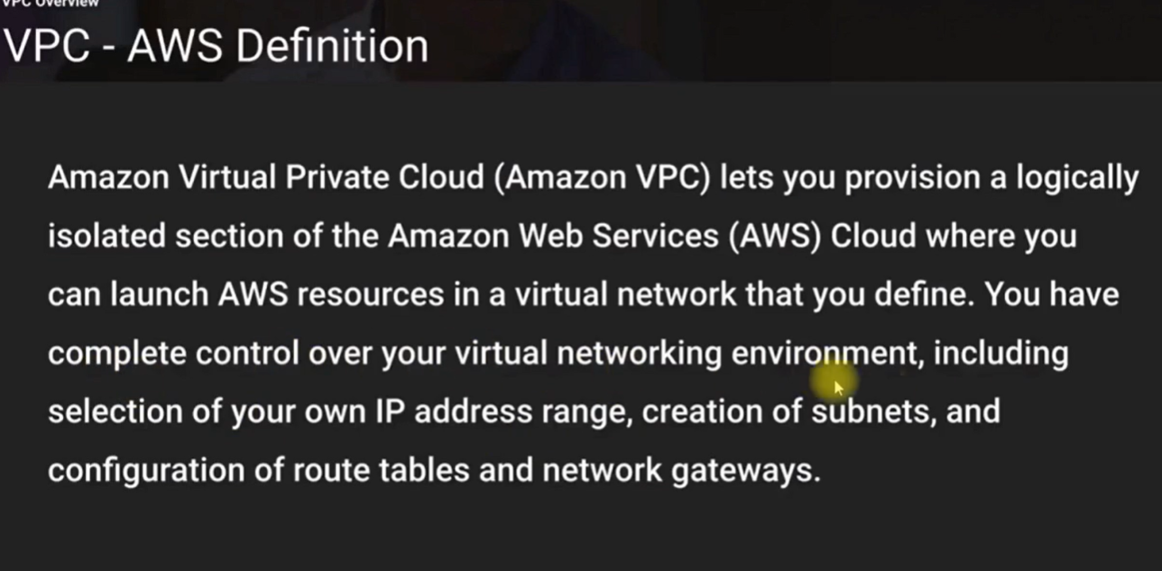

Slide 17
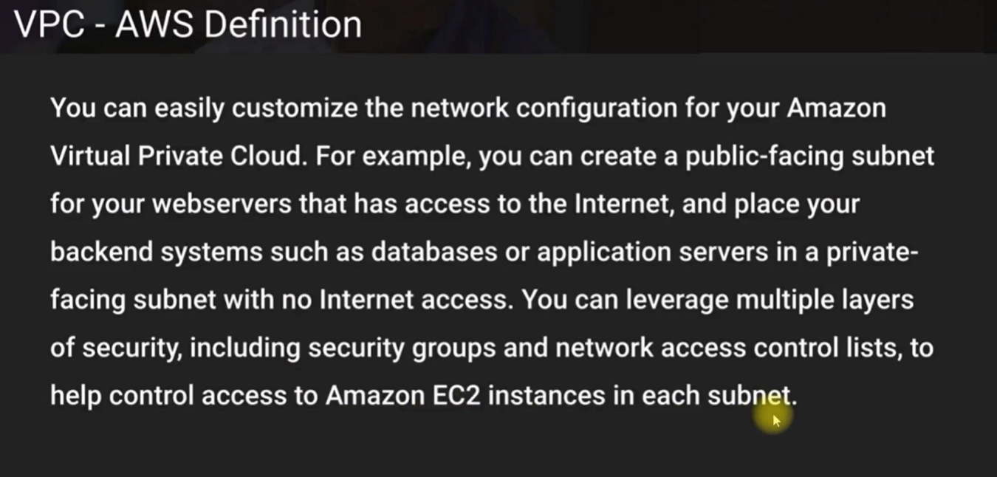

Slide 18
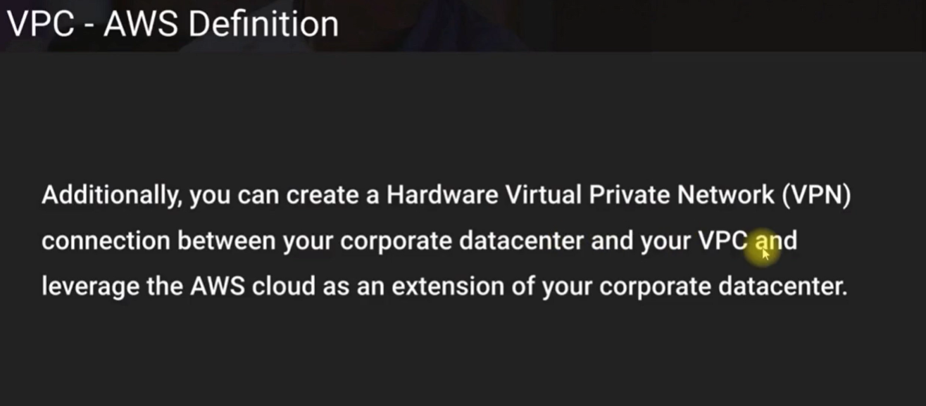

Slide 19
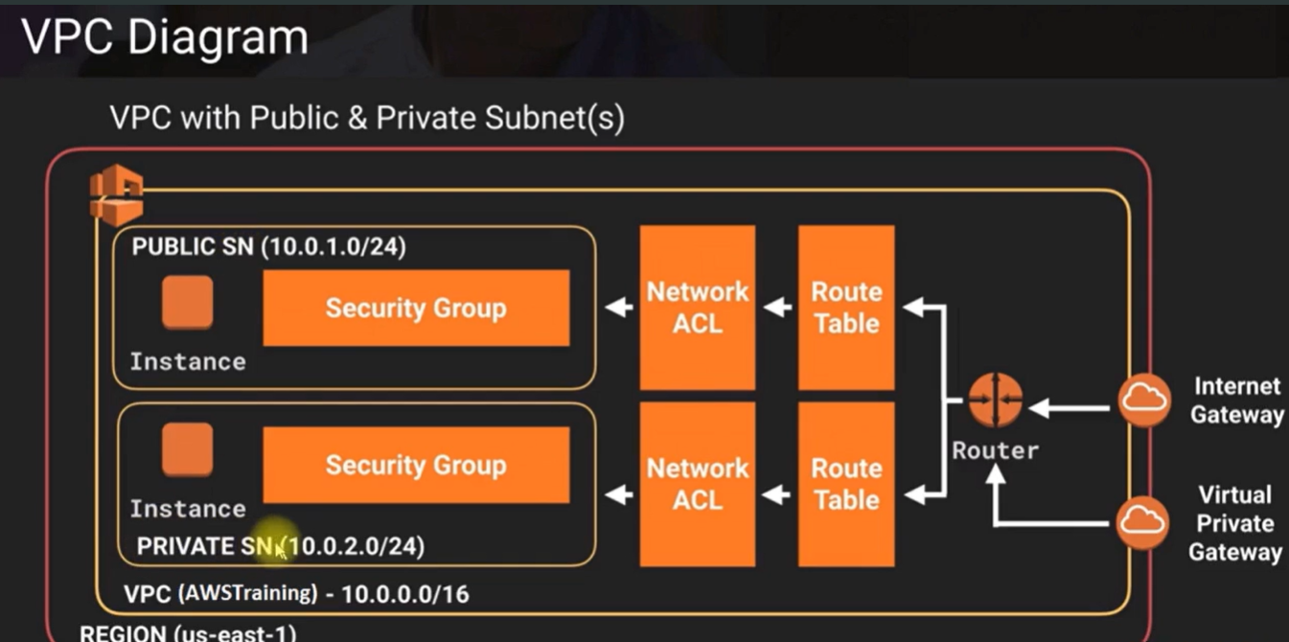

Slide 20
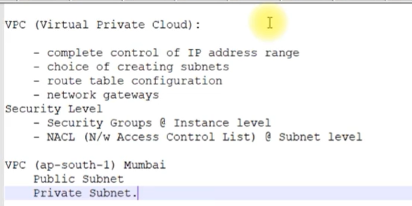

Slide 21
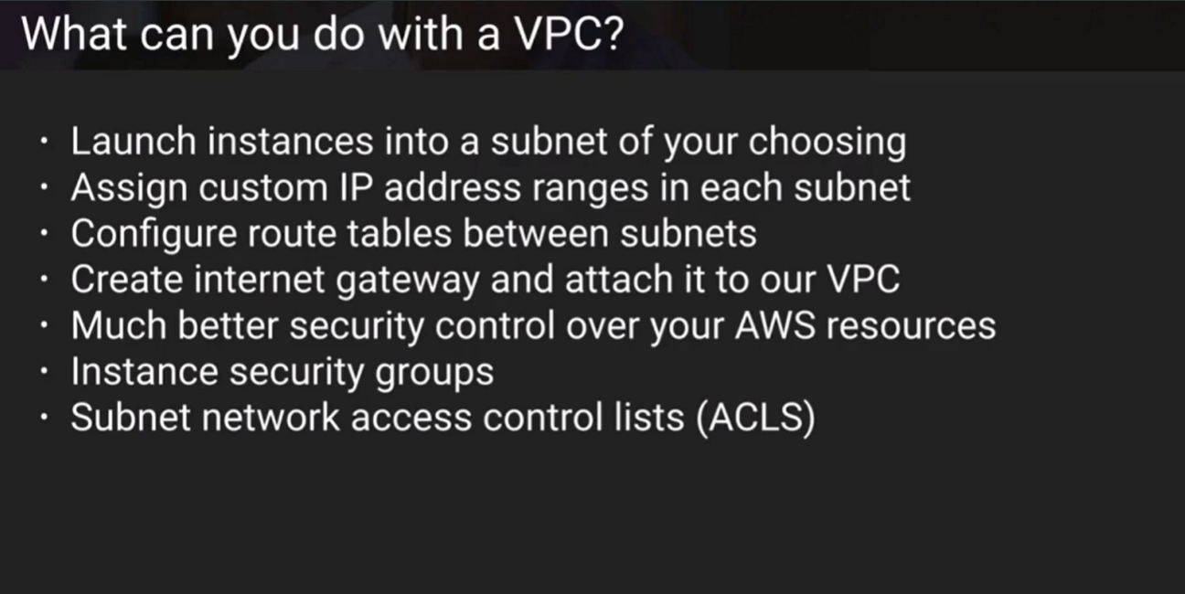

Slide 22
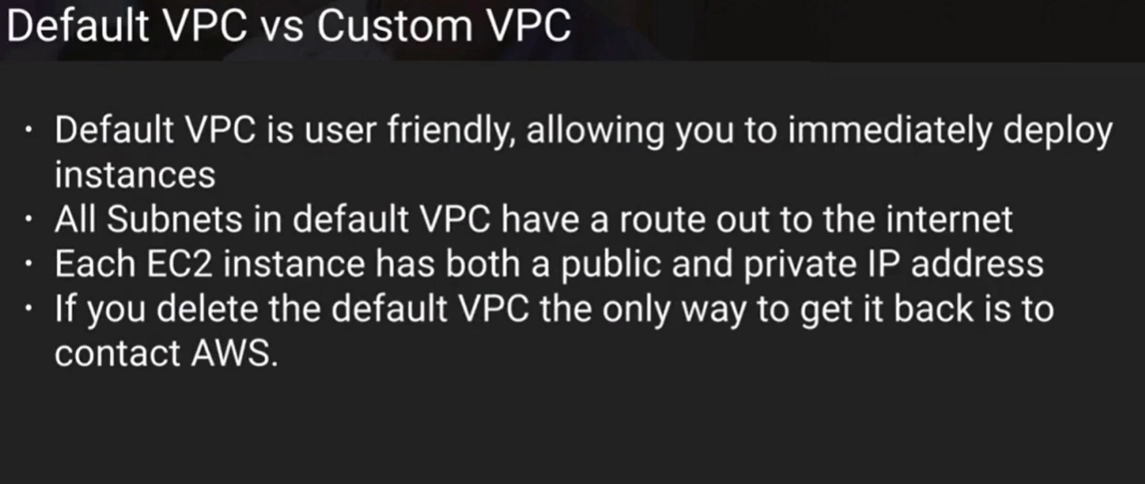

Slide 23
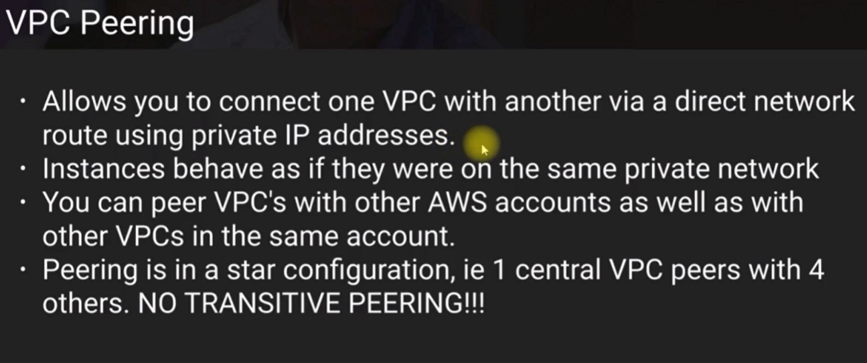

Slide 24
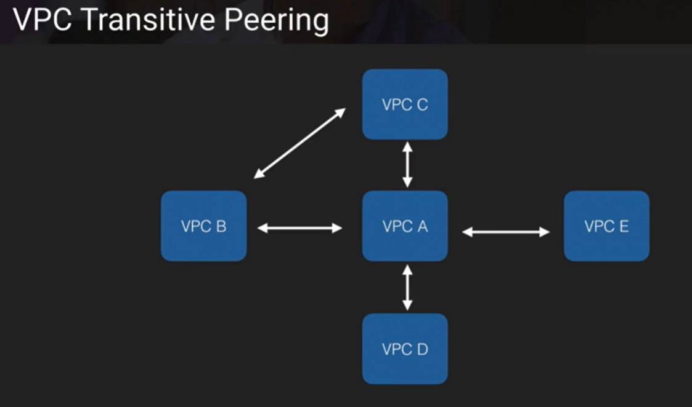

Slide 25
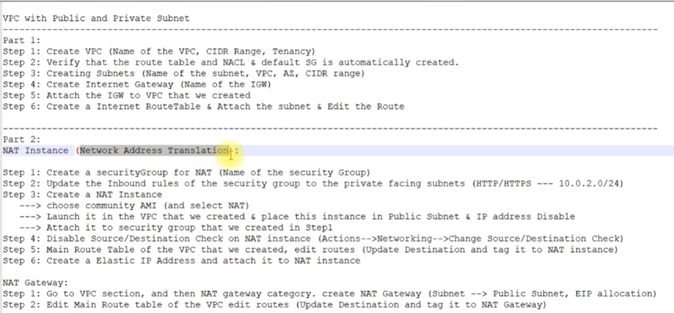

Slide 26
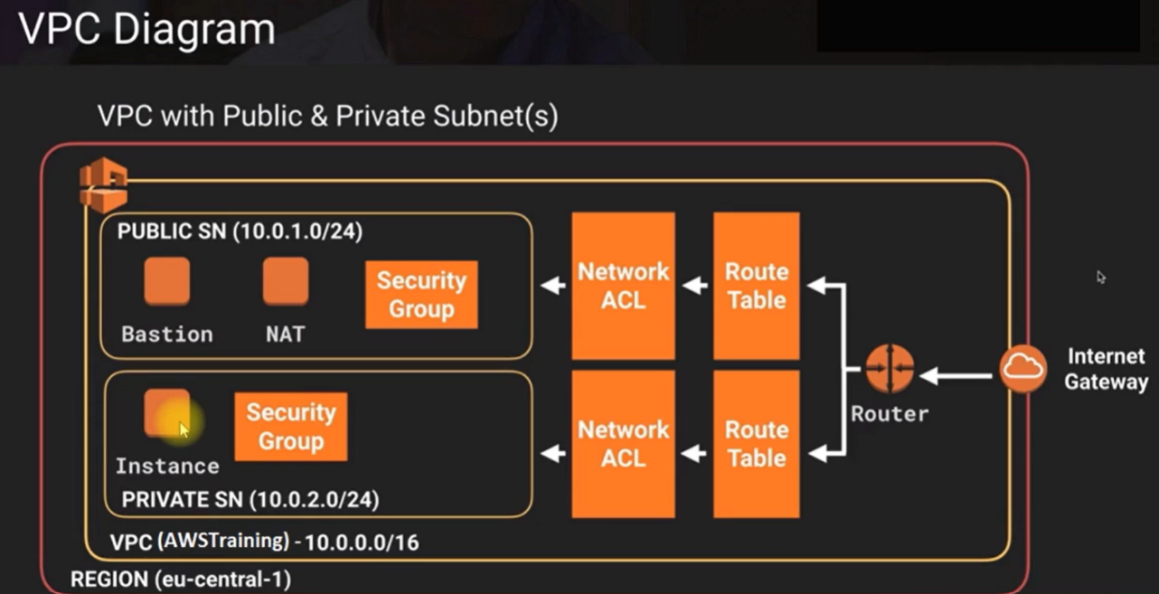

Slide 27
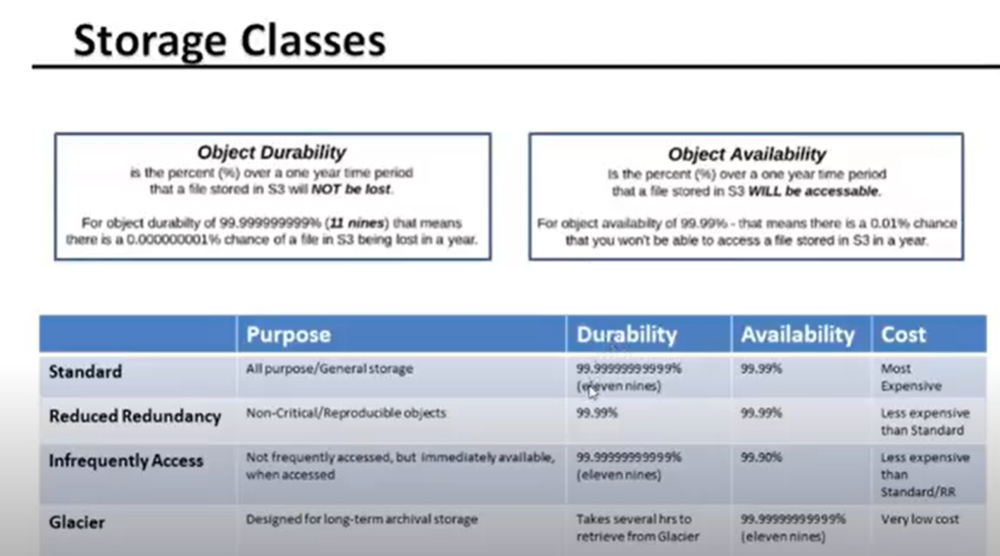

Slide 28
https://docs.aws.amazon.com/vpc/latest/userguide/extend-intro.html

Slide 29
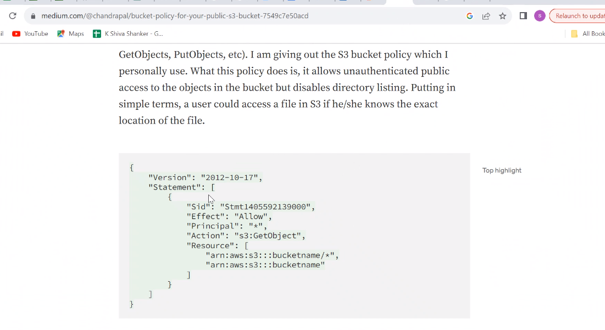

Slide 30
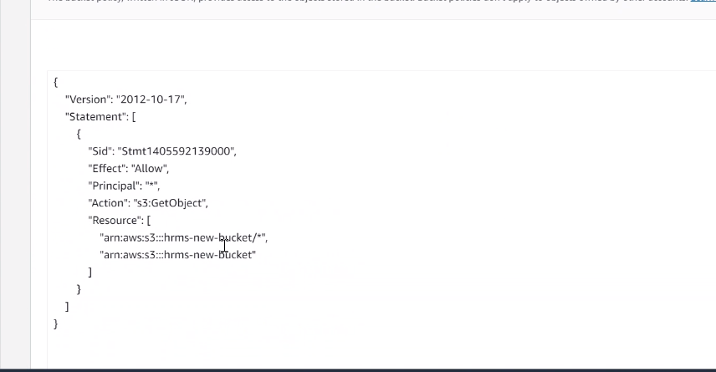

Slide 31
{
"Version": "2012-10-17",
"Id": "RestrictBucketToIAMUsersOnly",
"Statement": [
{
"Sid": "AllowOwnerOnlyAccess",
"Effect": "Deny",
"Principal": "*",
"Action": "s3:*",
"Resource": [
"arn:aws:s3:::your-bucket-name/*",
"arn:aws:s3:::your-bucket-name"
],
"Condition": {
"StringNotEquals": {
"aws:PrincipalArn": "arn:aws:iam::AWS_ACCOUNT_ID:root"
}
}
}
]
}

Slide 32
{
"Version": "2012-10-17",
"Statement": [
{
"Sid": "PublicReadGetObject",
"Effect": "Allow",
"Principal": "*",
"Action": [
"s3:GetObject"
],
"Resource": [
"arn:aws:s3:::<Bucket-Name>/*"
]
}
]
}

